Slide 1
Berthing Scheduling Application
Group #4
Osborn Collins
Mark A. Pascual
Driane Perez
Daniel Garcia
Justin Chuc
Kevin Godoy

Slide 2
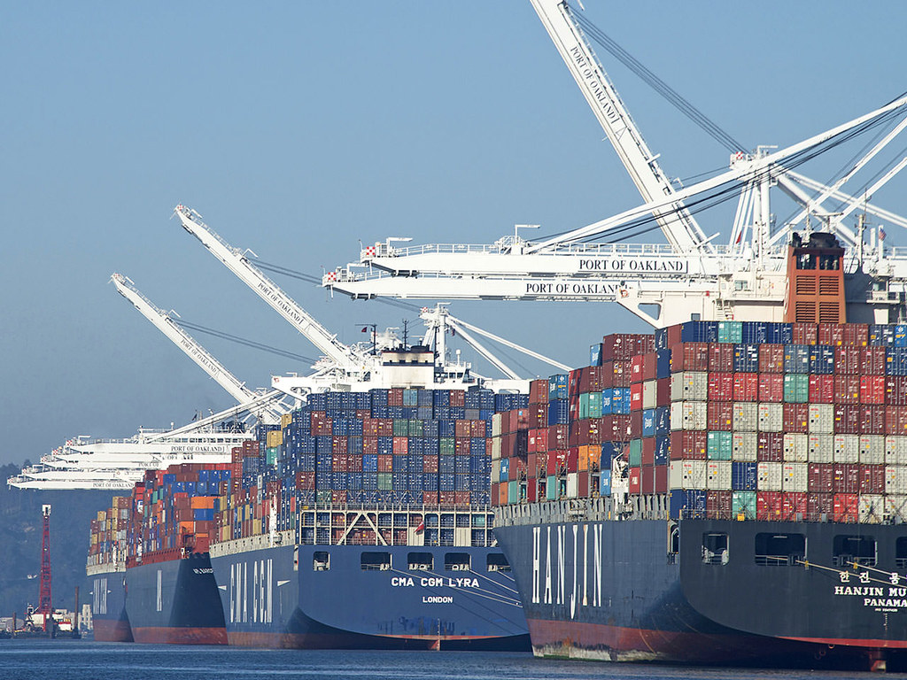

Slide 3
About our application
In the design of this application, we incorporated all the stakeholders at a Berthing facilities. Upon a user logging into our secure application, they will be forwarded to their appropriate dashboard where users can perform a range of tasks, see schedules, ship’s arrival and departure date and post notification of delays among other things.
This application is designed to be easy to use and improve the overall productivity of Berthing facilities.

Slide 4
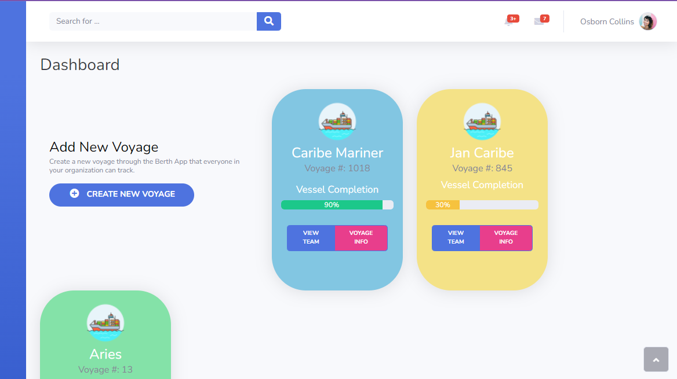
Dashboard

Slide 5
Summary of Changes
included functional requirements that were not listed in the table with the enumerated functional requirements.
Additional functional requirements effected changes to the traceability matrix
Additional functional requirements effected the fully dressed use cases.
The UIs designs incorporated in our first iteration were inadequate and were completely revised. The designs of the UIs incorporated the functional requirements that were updated and included.

Slide 6
History of Work
After reviewing the customer requirements and reviewing the nature of the project we developed report one.
report one challenging the guide provided was a bit vague.
the team was simultaneously working on other sections to be incorporated later on.
Two of the main components that were worked on were the database and user interfaces.
Subsequent to report one the team shifted its efforts to complete report two and demo one. In conjunction with report two the team developed the integration test and unit test for demo one.
Feedback from report one and two along with the feedback given for demo #1 and other guidelines are what are being incorporated into the final group report and demo.

Slide 7
Current Status
revamped UIs
Additional functional requirements
Main use cases implements

Slide 8
Future Work
pilot the application for a few months and give feedback for further development and improvements.
mobile version of the application (Develop a mobile app)
a responsive design

Slide 9
Demo presentation

Slide 10
The End!

